Slide 1
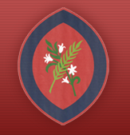

Year 6
Information Evening
Scan the QR code
for St Agatha’s Instagram:
Learning Together in God’s Love
September 2026

Slide 2
Welcome to Year 6
Flamingos Class
Mrs Bielska
Pelicans Class
Mrs de Jong

Slide 3
Curriculum
Topics
Maafa – learning about Africa’s past and present and the development of the slave trade; key text will be Freedom by Catherine Johnson
Britain at War – learning about the First and Second World Wars and how life was affected in Great Britain ; key text will be Letters to the Lighthouse by Emma Carroll

Slide 4
Class Saints
Flamingos Class
St Oscar Romero
Feast Day 24th March
Pelicans Class
St Rita
Feast Day 22nd May

Slide 5



Catholic Social Teaching
Your child will learn how they can apply the Catholic Social Teaching Principles in their learning and across school life.

Slide 6
Behaviour
‘DO YOUR BEST, LOOK YOUR BEST and ACT YOUR BEST’
We support children in helping them to understand that all actions/choices have consequences, both positive and negative. We encourage children to consider their choices and take responsibility for the consequences of these choices. We support children to reflect on the impact of unexpected behaviours on their own and others’ wellbeing.
We encourage children to focus their attention, to be ‘active listeners’ and to develop the capacity to make ‘good choices’ through noticing and praising positive behaviours.
In order to be able to challenge themselves and carry out tasks independently, children must be able to regulate their behaviour in the classroom.

Slide 7
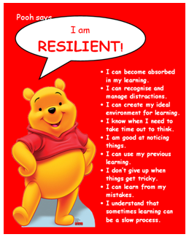

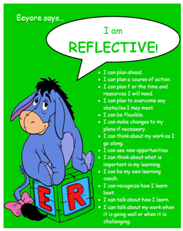

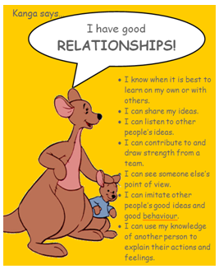
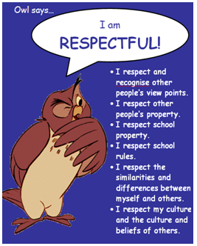
Learning to Learn…
Each half term, we focus on one of our Learning to Learn characters and Head Teacher certificates are awarded.

Slide 8
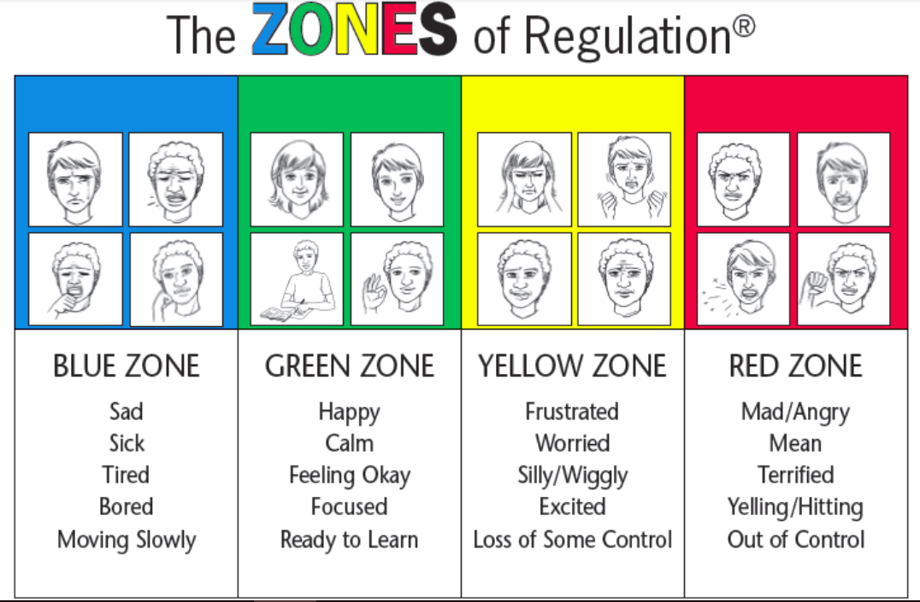
Zones of Regulation
We refer to the ‘Zones of Regulation’ to help pupils to think about their behaviour and how it impacts others.

Slide 9
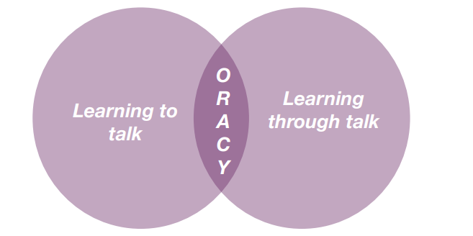
Oracy
DfE: ‘The value of talk to children’s mastery of language is as important for writing as it is for reading. Pupils should be taught how to engage in dialogue that enhances learning.
Oracy is the ability to articulate ideas, develop understanding and engage with others through spoken language.
As we build a culture of oracy across the school, listen out for these specific terms from St Agatha’s Oracy Framework: physical; linguistic; cognitive; and social and emotional.
Oracy is learning to talk and learning through talk. This is a school priority for this academic year to improve both spoken and written language.

Slide 10
Spelling
Spellings in Key Stage 2 are taught using a morphology approach.
Morphology is the study of the smallest units of meanings in language (morphemes) and is foundational to understanding how English words are structured.
There is a strong emphasis on spelling for writing.
Year group common exception spellings will be added to Google Classroom weekly. Please support your child in learning how to say and spell the words and their meaning. We will regularly check their progress.

Slide 11
Home Reading
Reading – encourage your child to read regularly and read more challenging books with your child.
Listen to and read along with audio books.
Suitable newspapers, magazines, comics, recipes etc.

Slide 12
School Library
The class will go to the library once a week.
They will be able to choose one book to take home.
Books must be returned before another can be taken out.
Library day is on Mondays (Flamingos) and Tuesdays (Pelicans)

Slide 13
Home Learning
Comprehension and SPaG (CGP books) set on alternate Mondays
Maths (CGP books) set every Monday
CGP homework should be marked and corrected as part of the home learning (this is not done at school)
Weekly spellings
All Home Learning books to be in school every Monday.
Reading every day – at least once a week with an adult

Slide 14
Uniform
Full school uniform – Winter / Summer
Suitable outdoor coat appropriate for the weather; we will still use the playground if it is raining (not torrential)
Smart haircuts, no “designer lines”
Small, plain hair accessories in school colours and long hair tied back
Small stud earrings (removed on PE days)
Watch – no other jewellery or nail varnish
Year 6 ties (with the winter uniform)
Water bottle – suitable lid/top!

Slide 15
PE
PE Days - Wednesday and Friday in Autumn (Spring and Summer Term - tbc)
Winter uniform
White PE t-shirt
Navy tracksuit bottoms
Red school tracksuit top
Sports trainers - not fashion trainers
Only the school logo is to be worn on clothing including socks
Summer uniform
White PE t-shirt
Red shorts
Sports trainers - not fashion trainers
Only the school logo is to be worn on clothing including socks

Slide 16
Active Minutes
“ Children and young people should engage in moderate to vigorous physical activity for an average of at least 60 minutes per day across the week. This can include all forms of activity such as physical education, active travel, after-school activities, play and sports” - GOV.UK
Children aged 5 and above should aim for at least 60 active minutes a day.
At school, we promote physical activity through PE, the Daily Mile, outdoor play and active learning.
At home, parents can help by encouraging walking, active play, family outings and active travel wherever possible.
Together, we can help children build healthy habits and meet the recommended levels of daily activity.

Slide 17
Swimming
Pelicans – 5 sessions, first lesson Friday 18th September
Flamingos – 5 sessions, first lesson Friday 6th November
swimming costume
towel
swimming cap (essential) and goggles
swimming sock (for verrucas)
plastic bag for wet items

Slide 18
Online Safety
Smart Devices - mobile phones and smart watches
Following updates to national safeguarding expectations, St Agatha’s is moving to become a smart device-free environment, which includes no smart phones and smart watches in school for children.
There are special circumstances where there are exceptions to this rule, such as if a child requires a mobile phone to monitor a medical need.
Social media age restrictions (WhatsApp)

Slide 19
Coming to and from school
Collection – please provide written permission, via email, for another adult to collect your child.
If your child will be walking to or from school alone, please fill in permission slips.
Please make sure your child is aware when they are walking home alone or being collected.

Slide 20
Key Dates
Applications for Secondary School Transfer – by Saturday 31st October at the latest
Parent / Teacher Consultations – Wednesday 14th October 4 - 7 pm and Thursday 15th October 1 - 4 pm
Wednesday 3rd February 4 - 7pm and Thursday 4th February 1pm - 4pm
KS2 tests (SATs) – w/b 10th May 2027
Year 6 Production – Thursday 15th July 2027
Year 6 Celebration Picnic - Wednesday 21st July 2027 from 3:30 till 6pm
Leavers’ Mass – Wednesday 21st July 2027 at 9:30 am

Slide 21
Key Dates
Class Trips
Junior Citizen Event – TBC
National Portrait Gallery – TBC
Residential – Henley Fort
Monday 7th – Wednesday 9th June 2027

Slide 22
KS2 Tests
Monday 10th May 2027 – Spelling, Punctuation and Grammar (SPaG)
Tuesday 11th May 2027 – Reading
Wednesday 12th May 2027 – Maths Arithmetic and Reasoning
Thursday 13th May 2027 – Maths Reasoning
Maths, Reading and SPaG are marked externally.
Writing is assessed internally.

Slide 23
PSA and
Class Reps
All of the adults in our school community are automatically members of the PSA.
The PSA do a fantastic job in supporting the children of St Agatha’s. Please do volunteer your time and support where you can.
We thank you for your support.

Slide 24
Year 6 Leavers’ Celebrations
Leavers’ year book – if you would like to have a detailed and colourful book, we ask for volunteers to do this (collect the photos, create and order books); otherwise, a small, ring-bound year book will be created by us.
Leavers’ hoodies – we ask for class reps or other Year 6 parents to organise and order these for us.
Leavers’ celebration – if you would like the celebration to finish with a slideshow documenting the children’s time at St Agatha’s School, we ask you as parents to create this.

Slide 25
Relationships and Sex Education
(RSE)
This is a continuation of the body changes sessions that the children took part in during Year 5.
We will be using the TenTen resources.
There will be further information regarding this at a later date.

Slide 26
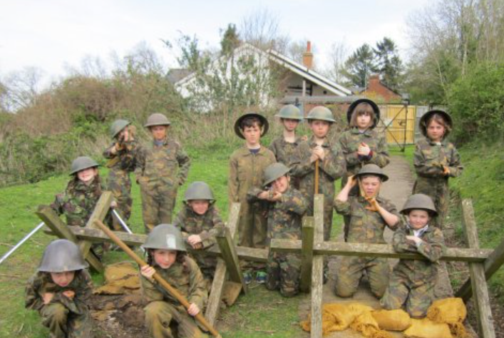
Henley Fort Residential
Monday 7th – Wednesday 9th June 2027
This is a 2 night outdoor activity trip.
The cost of the trip is approximately £250.
Henley Fort is located on the Hog's Back high above Guildford and is a Victorian Fort built during the late 19th Century to protect London from invasion by the French.
It is now an outdoor education facility offering challenging activities and a living historical experience in an authentic setting.
Notes:
PGL provides a wide range of top quality residential adventure and educational courses for more than 4,500 groups every year
All PGL centres and activities are risk assessed to comply with legal requirements and best practice. Risk assessments are available by request and on the PGL website
Centres are subject to the Adventure Activities Licensing Authority regulations (AALA) where appropriate
ABTA (Association of British Travel Agents) bonded means your money is protected
BAHA – British Activity Holiday Association. Responsible for establishing operating guidelines for the activity holiday industry
Through the Quality Badge Programme you can be confident that recognised providers fulfil all the necessary criteria as laid down by the DCSF, thereby better enabling Party Leaders to manage visits safely, efficiently and beneficially.

Slide 27
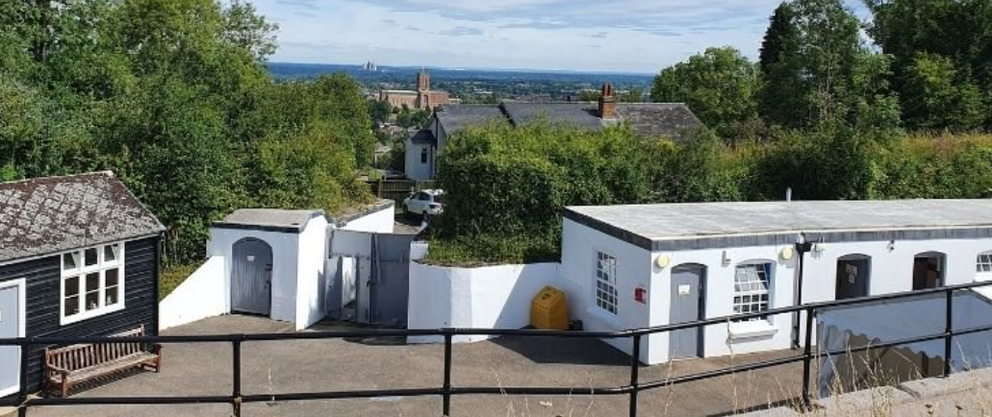
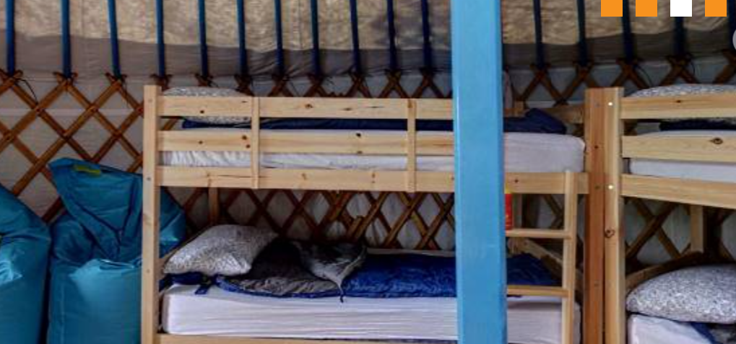
Historical Experiences and Outdoor Activities
Two historical activities:
home guards and air raid wardens
Open canoeing
Climbing
Orienteering
Challenge course
Notes:
Activities are chosen to suit the requirements of the group
4 x 1 ½ hour activity sessions every day
A full evening entertainments programme run by PGL staff includes discos, talent shows and quizzes
Benefits of a multi-activity course include:
- improved self confidence
- improved team-building skills
- better peer group relationships
- raised self esteem
- increased motivation.

Slide 28
Thank you for joining us this evening.
Learning Together in God’s Love

Slide 29
Thank you for coming!
Thank you for joining us this evening!

