Slide 1
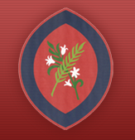

Year 5 Information Evening
Scan the QR code
for St Agatha’s Instagram:
Learning Together in God’s Love
September 2026
Notes:
Allie

Slide 2
Welcome to Year 5
Swans Class
Miss Cramby
Herons Class
Miss Styles
Notes:
Allie

Slide 3
Curriculum Topics
Autumn Term
Vikings
The Alps
Earth and Space
Spring Term
The Oceans
Pulleys and mechanisms
Tudors
Summer Term
Materials
The Desert
Developing recipes
Notes:
Emily

Slide 4
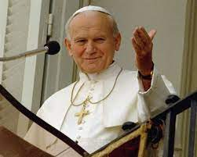
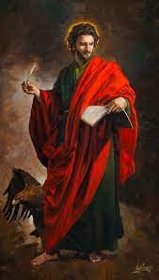
Class Saints
Swans – St John Paul II
Herons – St John the Apostle
Notes:
Emily

Slide 5
Behaviour
We aim to achieve a respectful, secure and safe environment where everyone shows consideration, kindness and honesty towards each other.
We use a range of rewards to reinforce the core values of the school and expected behaviours. We acknowledge where children have shown and developed various aspects of our RESPECT code.
This can be in the form of:
Verbal praise and feedback;
Talk with parents/carers at the end of the day about positive behaviour and engagement with learning;
Individual rewards e.g. stickers/postcards home;
House points;
Awarding certificates that promote the positive behaviour demonstrated.
Notes:
Emily

Slide 6
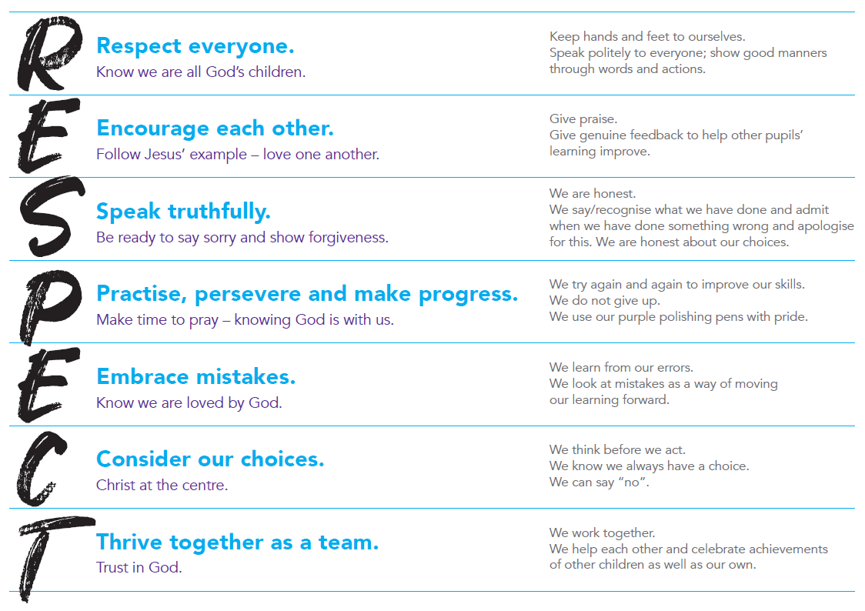
Behaviour
We prioritise the explicit teaching of expected and unexpected behaviours and relate this back to our RESPECT code.
Notes:
Emily

Slide 7
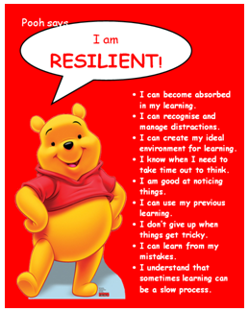
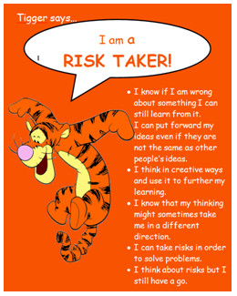
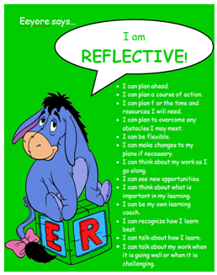

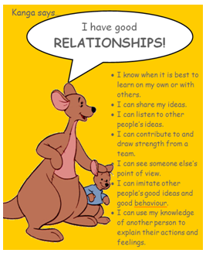
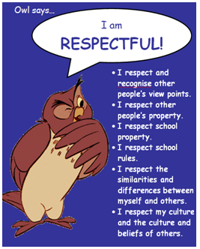
Learning to Learn…
Each half term, we focus on one of our Learning to Learn characters and Head Teacher certificates are awarded.
Notes:
Emily

Slide 8
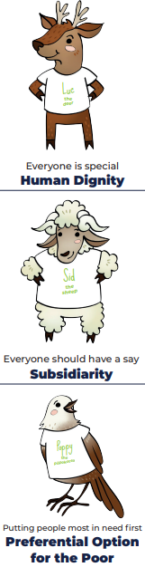


Catholic Social Teaching
Your child will learn how they can apply the Catholic Social Teaching Principles in their learning and across school life.
Notes:
Emily

Slide 9
Behaviour
‘DO YOUR BEST, LOOK YOUR BEST and ACT YOUR BEST’
We support children in helping them to understand that all actions/choices have consequences, both positive and negative. We encourage children to consider their choices and take responsibility for the consequences of these choices. We support children to reflect on the impact of unexpected behaviours on their own and others’ wellbeing.
We encourage children to focus their attention, to be ‘active listeners’ and to develop the capacity to make ‘good choices’ through noticing and praising positive behaviours.
In order to be able to challenge themselves and carry out tasks independently, children must be able to regulate their behaviour in the classroom.
Notes:
Emily

Slide 10
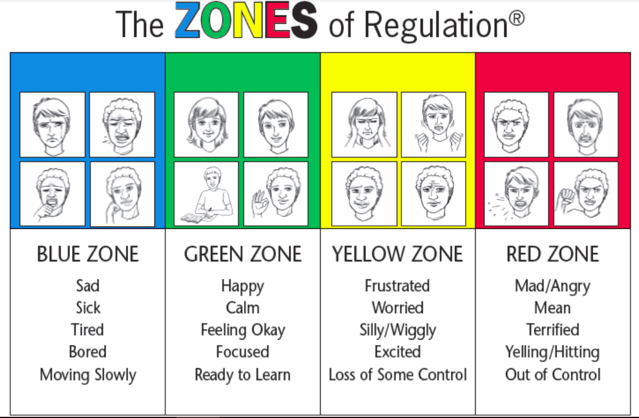
Zones of Regulation
We refer to the ‘Zones of Regulation’ to help pupils to think about their behaviour and how it impacts others.
Notes:
Allie

Slide 11
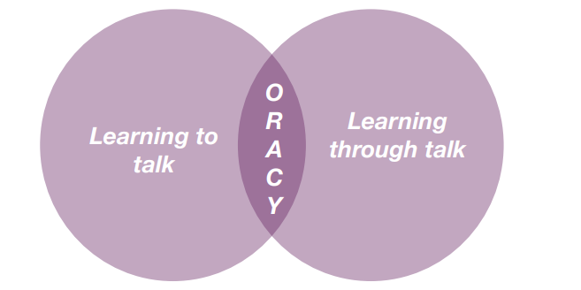
Oracy
DfE: ‘The value of talk to children’s mastery of language is as important for writing as it is for reading. Pupils should be taught how to engage in dialogue that enhances learning.
Oracy is the ability to articulate ideas, develop understanding and engage with others through spoken language.
As we build a culture of oracy across the school, listen out for these specific terms from St Agatha’s Oracy Framework: physical; linguistic; cognitive; and social and emotional.
Oracy is learning to talk and learning through talk. This is a school priority for this academic year to improve both spoken and written language.
Notes:
allie

Slide 12
Routines
Water bottle - children can refill in the classroom. Please make sure it is named.
Children should bring an appropriate snack for fruit time - no chocolate, sweets, cake or crisps. We are a nut free school.
Backpack (not too large)
Children walk into the classroom when the bell rings at 8.45am.
School pick up is at 3.15pm.
Notes:
Allie

Slide 13
Pencil cases
Pencil cases should be sensible and practical. They need to fit in trays and on the children’s tables.
Pencil cases should contain:
  HB pencils (3-4 good quality pencils are recommended)
  Blue handwriting pens (3-4 good quality pens are recommended)
  Colouring pencils
  Sharpener
  Large glue stick
  Rubber
  Ruler
Glue sticks are used frequently during the day and therefore need replenishing regularly. It is useful for the children to have a spare one in their school bag.
All pencils should be sharpened and all items should be clearly named.
Items such as novelty pens and rubbers can prove to be a distraction.
It is good for the children to get into the habit of taking their pencil case home regularly to sharpen pencils and so parents/carers can check if anything needs replenishing.
Notes:
Allie

Slide 14
Uniform
Full school uniform – Summer/Winter
Black school shoes – no trainers (except on PE days)
Only the school logo is be on clothing that is worn to school
Long hair tied back. Hair accessories must be plain, small and school colours/black/brown.
Small stud earrings allowed – do not wear on PE days. They should be taped over if newly pierced.
Watches are allowed (not smart watches)
No other jewellery
No nail varnish
Suitable outdoor coat appropriate for the weather; we will still use the playground if it is raining (not torrential).
Notes:
Allie

Slide 15
Online Safety
Smart Devices - mobile phones and smart watches
Following updates to national safeguarding expectations, St Agatha’s is moving to become a smart device-free environment, which includes no smart phones and smart watches in school for children.
There are special circumstances where there are exceptions to this rule, such as if a child requires a mobile phone to monitor a medical need.
Notes:
Allie

Slide 16
PE
Indoor PE – Thursday
Outdoor PE – Monday
Winter uniform
White PE t-shirt
Navy tracksuit bottoms
Red school tracksuit top
Sports trainers - not fashion trainers
Only the school logo is to be worn on clothing including socks
Summer uniform
White PE t-shirt
Red shorts
Sports trainers - not fashion trainers
Only the school logo is to be worn on clothing including socks
Notes:
Emily

Slide 17
Active Minutes
“ Children and young people should engage in moderate to vigorous physical activity for an average of at least 60 minutes per day across the week. This can include all forms of activity such as physical education, active travel, after-school activities, play and sports” - GOV.UK
Children aged 5 and above should aim for at least 60 active minutes a day.
At school, we promote physical activity through PE, the Daily Mile, outdoor play and active learning.
At home, parents can help by encouraging walking, active play, family outings and active travel wherever possible.
Together, we can help children build healthy habits and meet the recommended levels of daily activity.
Notes:
Emily

Slide 18
Home Learning
Reading – every day
Reading Comprehension CGP book (fortnightly)
Grammar, Punctuation and Spelling CGP book (fortnightly)
Maths CGP book (weekly)
Children will record the Home Learning in their GCP books each Monday. It will also be on Google Classroom every Monday.
Notes:
Emily

Slide 19
Spelling
Spellings in Key Stage 2 is taught using a morphology approach.
Morphology is the study of the smallest units of meanings in language (morphemes) and is foundational to understanding how English words are structured.
The National Curriculum will be taught through objectives. There is a strong emphasis on spelling for writing and not for weekly memory tests.
As a year group, we will be testing the children half termly on the objectives they have covered which will be shared with you on Google Classroom each week after they have been taught.
Up to ten year group common exception spellings will be added to Google Classroom each half term. Your child will be tested on these at the end of a half term. Please support them in learning how to say and spell the words and their meaning.
This means that there will not be weekly spelling home learning.
Notes:
Emily

Slide 20
Home Reading
All children should be reading every day to develop a love of reading. Please read with your child so they are hearing more challenging vocabulary.
Children will also have the opportunity to borrow a book from the school library.
We will not be allowing comic style books to be read during the school day. These may be read for pleasure at the weekend.
Notes:
Emily

Slide 21
School
Library
All children have the opportunity to go to the school library each week.
Year 5 will all visit the library once a week.
Please encourage your child to look after the school library books and return the book when they have finished it. In order to take out another book, they must return the previous book.
Notes:
Allie

Slide 22
RSE
(Relationships and Sex Education)
To teach RSE, we use TenTen resources. All information regarding these lessons is on our school website.
There will be further information regarding this at a later date.
Notes:
Allie

Slide 23
PSA and Class Reps
All of the adults in our school community are automatically members of the PSA.
The PSA do a fantastic job in supporting the children of St Agatha’s. Please do volunteer your time and support where you can.
Those able to take on the role of class rep are greatly appreciated. It is not a huge job!
Notes:
Allie

Slide 24
Drop off and pick up…
Collections – Please provide written permission or email the office if another adult is going to collect your child.
At the end of the day, children must tell their teacher who is there to collect them before they leave.
Notes:
Allie

Slide 25
Key Dates
Autumn and Spring Term: Parent / Teacher Consultations – school
closes at 12pm
Thursday 15th October
Thursday 4th February
Summer Term: Written reports
Thames Young Mariners Trip – Wednesday 28th April 2027
Swimming – Spring Term
Rockstars and Robots Day - Friday 18th September
Oracy Vocabulary Day - Friday 2nd October
Notes:
Emily

Slide 26
Thank you for coming!
Thank you for joining us this evening!
Notes:
Emily

