Slide 1
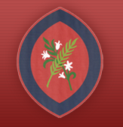

Year 3 Information Evening
Scan the QR code
for St Agatha’s Instagram:
Learning Together in God’s Love
September 2026

Slide 2
Welcome to Year 3
Swifts Class
Ms Campbell
Ms Maycock (Thursday)

Slide 3
Curriculum Topics
Autumn Term
Stone Age, Bronze Age and Iron Age
Skeletal and Muscular Systems
Rocks and Volcanoes
Spring Term
Romans
Forces and Magnets
Summer Term
Plants
Light & Shadow

Slide 4
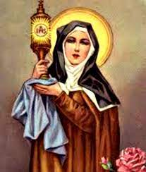
Class Saints
Swifts – St. Clare of Assisi

Slide 5
Behaviour
We aim to achieve a respectful, secure and safe environment where everyone shows consideration, kindness and honesty towards each other.
We use a range of rewards to reinforce the core values of the school and expected behaviours. We acknowledge where children have shown and developed various aspects of our RESPECT code.
This can be in the form of:
Verbal praise and feedback;
Talk with parents/carers at the end of the day about positive behaviour and engagement with learning;
Individual rewards e.g. stickers/postcards home;
House points;
Awarding certificates that promote the positive behaviour demonstrated.

Slide 6
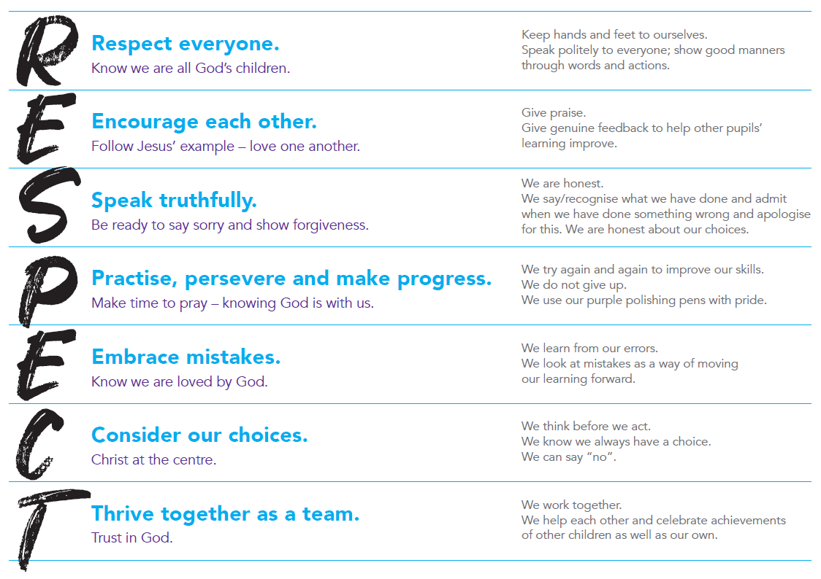
Behaviour
We prioritise the explicit teaching of expected and unexpected behaviours and relate this back to our RESPECT code.

Slide 7
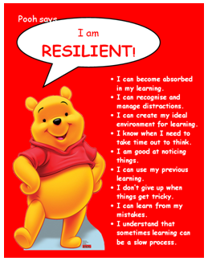
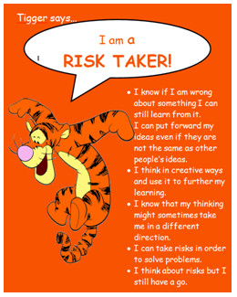
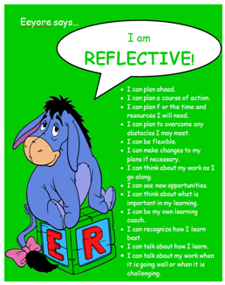

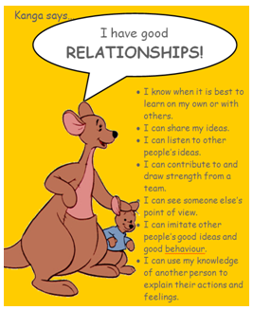
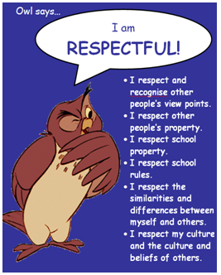
Learning to Learn…
Each half term, we focus on one of our Learning to Learn characters and Head Teacher certificates are awarded.

Slide 8
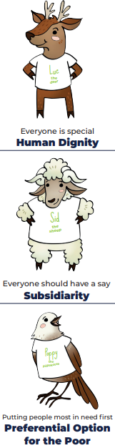


Catholic Social Teaching
Your child will learn how they can apply the Catholic Social Teaching Principles in their learning and across school life.

Slide 9
Behaviour
‘DO YOUR BEST, LOOK YOUR BEST and ACT YOUR BEST’
We support children in helping them to understand that all actions/choices have consequences, both positive and negative. We encourage children to consider their choices and take responsibility for the consequences of these choices. We support children to reflect on the impact of unexpected behaviours on their own and others’ wellbeing.
We encourage children to focus their attention, to be ‘active listeners’ and to develop the capacity to make ‘good choices’ through noticing and praising positive behaviours.
In order to be able to challenge themselves and carry out tasks independently, children must be able to regulate their behaviour in the classroom.

Slide 10
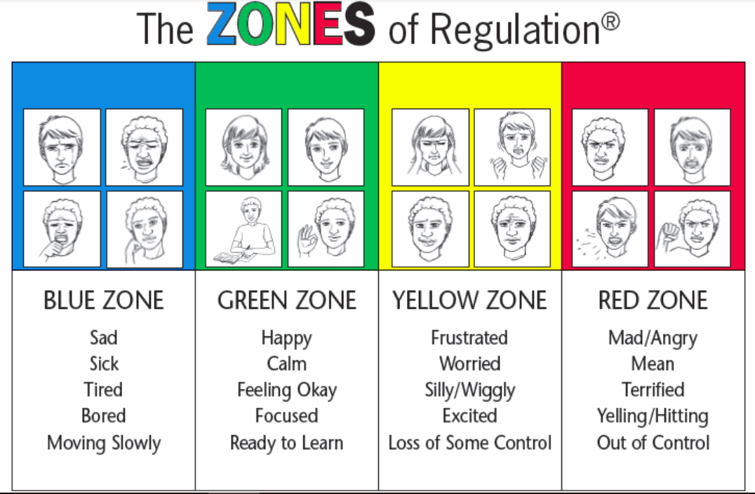
Zones of Regulation
We refer to the ‘Zones of Regulation’ to help pupils to think about their behaviour and how it impacts others.

Slide 11
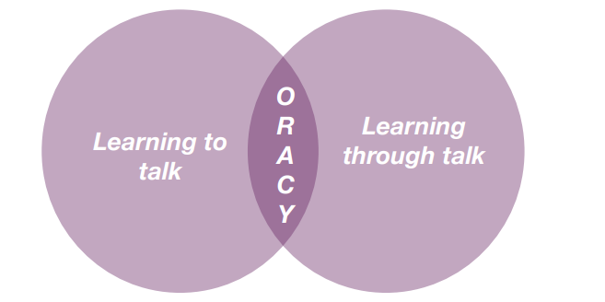
Oracy
DfE: ‘The value of talk to children’s mastery of language is as important for writing as it is for reading. Pupils should be taught how to engage in dialogue that enhances learning.
Oracy is the ability to articulate ideas, develop understanding and engage with others through spoken language.
As we build a culture of oracy across the school, listen out for these specific terms from St Agatha’s Oracy Framework: physical; linguistic; cognitive; and social and emotional.
Oracy is learning to talk and learning through talk. This is a school priority for this academic year to improve both spoken and written language.

Slide 12
Routines
Water bottle - children can refill in the classroom. Please make sure it is named.
Children should bring a healthy snack for fruit time – no crisps, biscuits, cake or chocolate. We are a nut free school.
Backpack (not too large) – book bags are no longer needed.
Children to bring their own pencil case.
No afternoon play.
Come into the classroom at 8.45am. Registration is at 8:50am.
School pick up at 3.15pm

Slide 13
Pencil Cases
Pencil cases should be sensible and practical. They need to fit in trays and on the children’s tables. Children should only have ONE pencil case in school.
Pencil cases should contain:
  HB pencils (3-4 good quality pencils are recommended)
  Colouring pencils
  Sharpener
  Large glue stick
  Rubber
Glue sticks are used frequently during the day and therefore need replenishing regularly. It is useful for the children to have a spare one in their school bag.
All pencils should be sharpened and all items should be clearly named.
Items such as gel pens, felt tip pens, novelty rubbers, highlighters are not required and prove to be a distraction to many children in lessons. Children will be provided with a 30cm ruler, scissors and whiteboard pen.
It is good for the children to get into the habit of taking their pencil case home regularly to sharpen pencils and so parents/carers can check if anything needs replenishing. Please make sure they come back to school.

Slide 14
Uniform
Full school uniform – Summer/Winter
Black school shoes – no trainers (except on PE days)
Only the school logo is on clothing that is worn to school
Long hair tied back. Hair accessories must be plain, small and school colours/black/brown.
Small stud earrings allowed – do not wear on PE days. They should be taped over if newly pierced.
Watches are allowed (not smart watches)
No other jewellery
No nail varnish
Suitable outdoor coat appropriate for the weather; we will still use the playground if it is raining (not torrential).

Slide 15
Online Safety
Smart Devices - mobile phones and smart watches
Following updates to national safeguarding expectations, St Agatha’s is moving to become a smart device-free environment, which includes no smart phones and smart watches in school for children.
There are special circumstances where there are exceptions to this rule, such as if a child requires a mobile phone to monitor a medical need.

Slide 16
P.E.
Winter uniform
White PE t-shirt
Navy tracksuit bottoms
Red school tracksuit top
Sports trainers - not fashion trainers
Only the school logo is to be worn on clothing including socks
Summer uniform
White PE t-shirt
Red shorts
Sports trainers - not fashion trainers
Only the school logo is to be worn on clothing including socks

Slide 17
Active Minutes
“ Children and young people should engage in moderate to vigorous physical activity for an average of at least 60 minutes per day across the week. This can include all forms of activity such as physical education, active travel, after-school activities, play and sports” - GOV.UK
Children aged 5 and above should aim for at least 60 active minutes a day.
At school, we promote physical activity through PE, the Daily Mile, outdoor play and active learning.
At home, parents can help by encouraging walking, active play, family outings and active travel wherever possible.
Together, we can help children build healthy habits and meet the recommended levels of daily activity.

Slide 18
Home Learning
Reading – every day
Reading Comprehension CGP Book (fortnightly).
Grammar, Punctuation and Spelling CGP Book (fortnightly)
Maths CGP book (fortnightly)
Times Tables – Please practise times tables at home. The expectation is that children are spending 15 minutes on this weekly.

Slide 19
Spelling
Spellings in Key Stage 2 are taught using a morphology approach.
Morphology is the study of the smallest units of meanings in language (morphemes) and is foundational to understanding how English words are structured.
The National Curriculum will be taught through objectives. There is a strong emphasis on spelling for writing and not for weekly memory tests.
As a year group, we will be testing the children half termly on the objectives they have covered which will be shared with you on Google Classroom each week after they have been taught.
Up to ten year group common exception spellings will be added to Google Classroom each half term. Your child will be tested on these at the end of a half term. Please support them in learning how to say and spell the words and their meaning.
This means that there will not be weekly spelling home learning.

Slide 20
Home Reading
All children should be sharing engaging storybooks with you every day to develop a love of reading. Please talk to your child about the books you read together and ask them questions about the text. Please do read to your child, at a higher level, so they are hearing more challenging vocabulary.
All children choose a reading book to take home from the library.
Children are given the responsibility of changing and selecting their books themselves.

Slide 21
School
Library
All children have the opportunity to go to the school library each week.
The library is also open for Year 3 to visit at lunchtimes on Mondays, Tuesdays and Wednesdays.
Please encourage your child to look after the school library books and return the book when they have finished it. In order to take out another book, they must return the previous book.

Slide 22
PSA and Class Reps
All of the adults in our school community are automatically members of the PSA.
The PSA do a fantastic job in supporting the children of St Agatha’s. Please do volunteer your time and support where you can.
Those able to take on the role of class rep are greatly appreciated. It is not a huge job!

Slide 23
Drop off and pick up…
Children come directly into class when the bell is rung at 8:45am.
Collections – Please provide written permission or email the office if another adult is going to collect your child.
At the end of the day, children must tell their teacher who is there to collect them before they leave.

Slide 24
Key Dates
Autumn and Spring Term: Parent / Teacher Consultations – school closes at 12pm
Thursday 15th October
Thursday 4th February
Summer Term: Written reports
PE Kit Days –
Tuesday (outdoor) & Friday (indoor) – these days may change through the year.
Children are to come into school wearing their PE kit on their PE days.
Please make sure earrings are removed at home on PE days.

Slide 25
Thank you for coming!
Thank you for joining me this evening.

