Slide 1
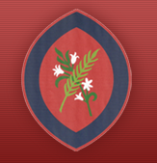

Year 2 Information Evening
Scan the QR code
for St Agatha’s Instagram:
Learning Together in God’s Love
September 2026

Slide 2
Curriculum Topics
Autumn Term
Old school
Spring Term
Coastline
Summer Term
Magnificent Monarchs

Slide 3
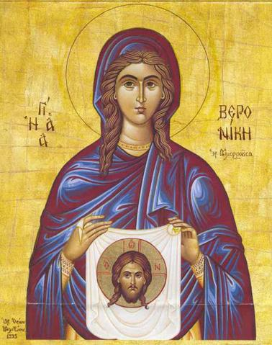
Class Saint
Doves – St. Veronica
12th July

Slide 4
Behaviour
‘DO YOUR BEST, LOOK YOUR BEST and ACT YOUR BEST’
We support children in helping them to understand that all actions/choices have consequences, both positive and negative. We encourage children to consider their choices and take responsibility for the consequences of these choices. We support children to reflect on the impact of unexpected behaviours on their own and others’ wellbeing.
We encourage children to focus their attention, to be ‘active listeners’ and to develop the capacity to make ‘good choices’ through noticing and praising positive behaviours.
In order to be able to challenge themselves and carry out tasks independently, children must be able to regulate their behaviour in the classroom.

Slide 5
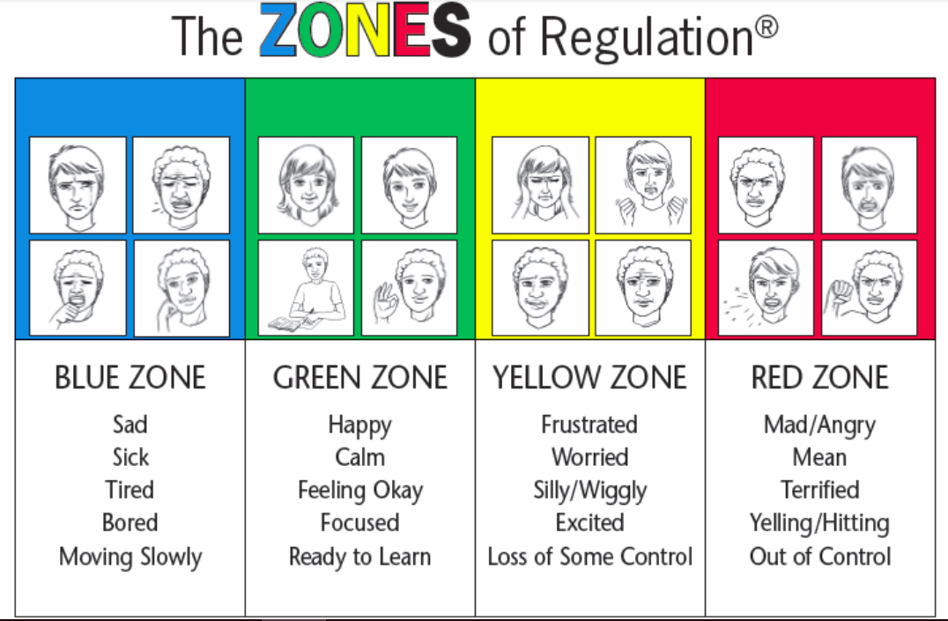
Zones of Regulation
We refer to the ‘Zones of Regulation’ to help pupils to think about their behaviour and how it impacts others.

Slide 6
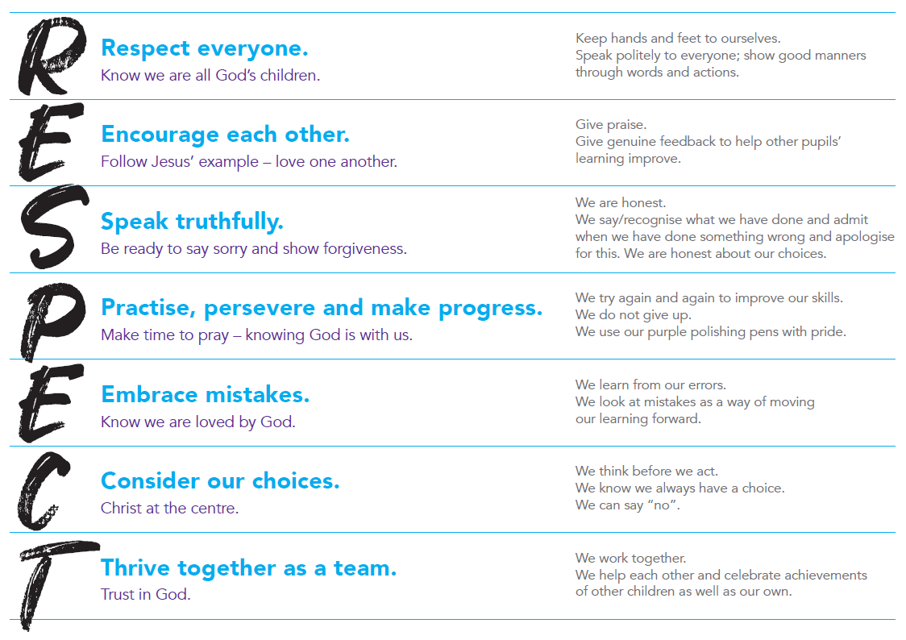
Behaviour
We prioritise the explicit teaching of expected and unexpected behaviours and relate this back to our RESPECT code.

Slide 7



Catholic Social Teaching
Your child will learn how they can apply the Catholic Social Teaching Principles in their learning and across school life.

Slide 8
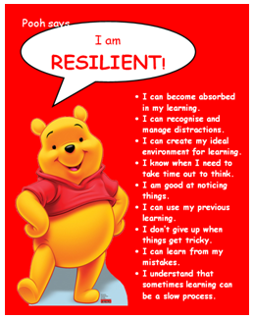
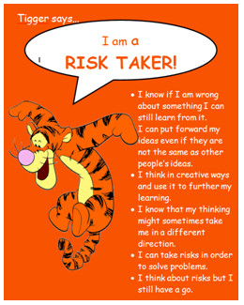
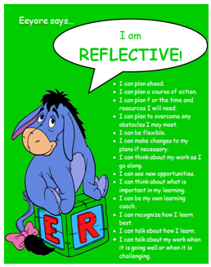

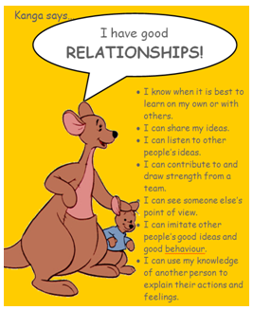

Learning to Learn
Each half term, we focus on one of our Learning to Learn characters and Head Teacher certificates are awarded.

Slide 9
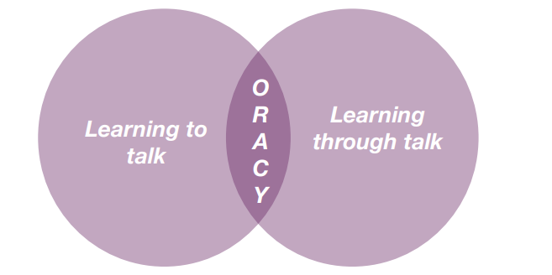
Oracy
DfE: ‘The value of talk to children’s mastery of language is as important for writing as it is for reading. Pupils should be taught how to engage in dialogue that enhances learning.
Oracy is the ability to articulate ideas, develop understanding and engage with others through spoken language.
As we build a culture of oracy across the school, listen out for these specific terms from St Agatha’s Oracy Framework: physical; linguistic; cognitive; and social and emotional.
Oracy is learning to talk and learning through talk. This is a school priority for this academic year to improve both spoken and written language.

Slide 10
Routines
Water bottle (children can refill in the classroom). Please make sure it is named.
Children can bring a snack for fruit time – fruit or vegetables. We are a nut free school.
Backpack (not too large).
Children to bring their own pencil case.
Coming into the classroom from 8.45am.
School pick up at 3.15pm.
Lost property – red basket.

Slide 11
Uniform
Full school uniform – Summer/Winter
Black school shoes – no trainers (except on PE days)
Only the school logo is be on clothing that is worn to school
Long hair tied back. Hair accessories must be plain, small and school colours/black/brown.
Small stud earrings allowed – do not wear on PE days. They should be taped over if newly pierced.
Watches are allowed (not smart watches)
No other jewellery
No nail varnish
Suitable outdoor coat appropriate for the weather; we will still use the playground if it is raining (not torrential).

Slide 12
Online Safety
Smart Devices - mobile phones and smart watches
Following updates to national safeguarding expectations, St Agatha’s is moving to become a smart device-free environment, which includes no smart phones and smart watches in school for children.
There are special circumstances where there are exceptions to this rule, such as if a child requires a mobile phone to monitor a medical need.

Slide 13
P.E.
Winter uniform
White PE t-shirt
Navy tracksuit bottoms
Red school tracksuit top
Sports trainers - not fashion trainers
Only the school logo is to be worn on clothing including socks
Summer uniform
White PE t-shirt
Red shorts
Sports trainers - not fashion trainers
Only the school logo is to be worn on clothing including socks

Slide 14
Active Minutes
“ Children and young people should engage in moderate to vigorous physical activity for an average of at least 60 minutes per day across the week. This can include all forms of activity such as physical education, active travel, after-school activities, play and sports” - GOV.UK
Children aged 5 and above should aim for at least 60 active minutes a day.
At school, we promote physical activity through PE, the Daily Mile, outdoor play and active learning.
At home, parents can help by encouraging walking, active play, family outings and active travel wherever possible.
Together, we can help children build healthy habits and meet the recommended levels of daily activity.

Slide 15
Home Learning
Reading books are assigned online each week.
Mental maths (e.g. times tables) sent home weekly – test every 2 weeks. *From March*
Spelling- sent home weekly - test to revise the common exception words every 2 weeks. *From March*
Reading comprehension will begin after Easter and take place every two weeks.

Slide 16
School Library
All children will be given the opportunity to go to the school library each week.
Year 2 children will go to the library on a Wednesday.
Please encourage your child to look after the school library books and return the book when they have finished it. In order to take out another book they must return the previous book.

Slide 17
Assessment
Year 2 children no longer take SATs tests.
Regular teacher assessment will continue to take place.

Slide 18
PSA and Class Reps
All of the adults in our school community are automatically members of the PSA.
The PSA do a fantastic job in supporting the children of St Agatha’s. Please do volunteer your time and support where you can.
Those able to take on the role of class rep are greatly appreciated.

Slide 19
Drop off and pick up
Children come straight into class when the bell is rung at 8:45am. They should be in class by 8:50am for registration.
Collection – Please provide written permission or email the office if another adult is going to collect your child.
At the end of the day, children must tell their teacher who is there to collect them before they leave.

Slide 20
Key Dates
Autumn and Spring Term: Parent / Teacher Consultations – school closes at 12pm
Thursday 15th October
Thursday 4th February
Summer Term: Written reports
PE Kit Days –
Monday (indoor) & Tuesday (outdoor) – these days may change through the year.
Children are to come into school wearing their PE kit on their PE days.
Please make sure earrings are removed at home on PE days.
Rockstars and Robots Day - Friday 18th September
Oracy Vocabulary Day - Friday 2nd October
KS1 Christmas Nativity - Tuesday 8th December at 2pm

Slide 21
Thank you for coming!
Thank you for joining us this evening!

