Slide 1
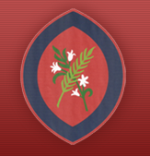

Year 1 Information Evening
Scan the QR code
for St Agatha’s Instagram:
Learning Together in God’s Love
September 2026

Slide 2
Welcome to Year 1
Hummingbirds Class
Mrs Mitchell and Miss Morris
Larks Class
Miss Brown

Slide 3
Curriculum
Topics
Autumn
How am I making History?
Seasonal changes
Spring
Toys from now and the past
The 5 senses
Summer
Explorers
Our local area and Shanghai

Slide 4
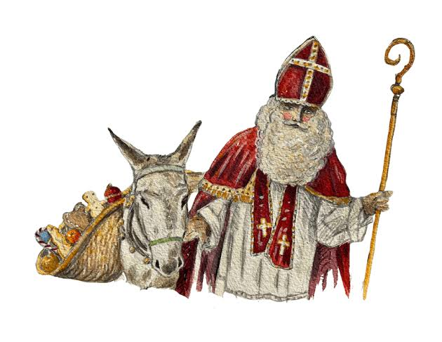
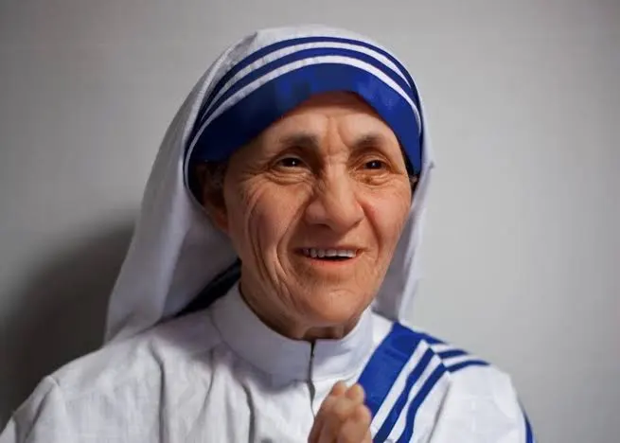
Class Saints
Hummingbirds- St Nicolas
Larks- St. Teresa of Calcutta

Slide 5
Behaviour
‘DO YOUR BEST, LOOK YOUR BEST and ACT YOUR BEST’
We support children in helping them to understand that all actions/choices have consequences, both positive and negative. We encourage children to consider their choices and take responsibility for the consequences of these choices. We support children to reflect on the impact of unexpected behaviours on their own and others’ wellbeing.
We encourage children to focus their attention, to be ‘active listeners’ and to develop the capacity to make ‘good choices’ through noticing and praising positive behaviours.
In order to be able to challenge themselves and carry out tasks independently, children must be able to regulate their behaviour in the classroom.

Slide 6
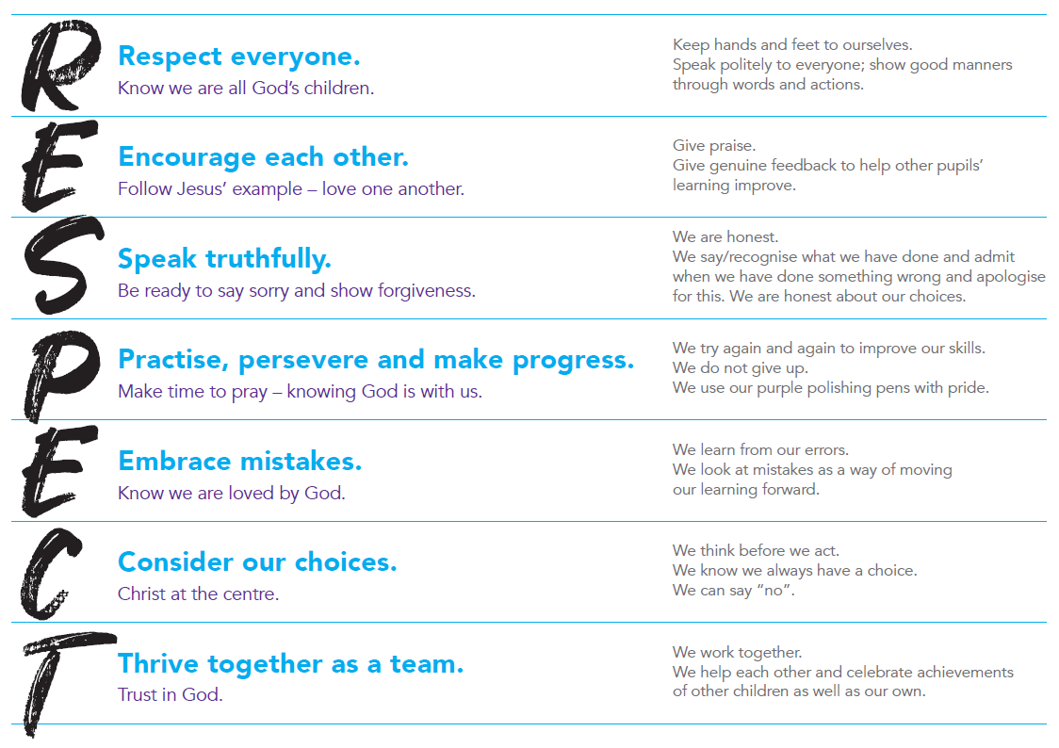
Behaviour
We prioritise the explicit teaching of expected and unexpected behaviours and relate this back to our RESPECT code.

Slide 7


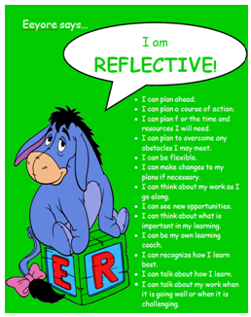

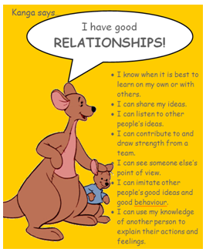

Learning to Learn…

Slide 8



Catholic Social Teaching
Your child will learn how they can apply the Catholic Social Teaching Principles in their learning and across school life.

Slide 9
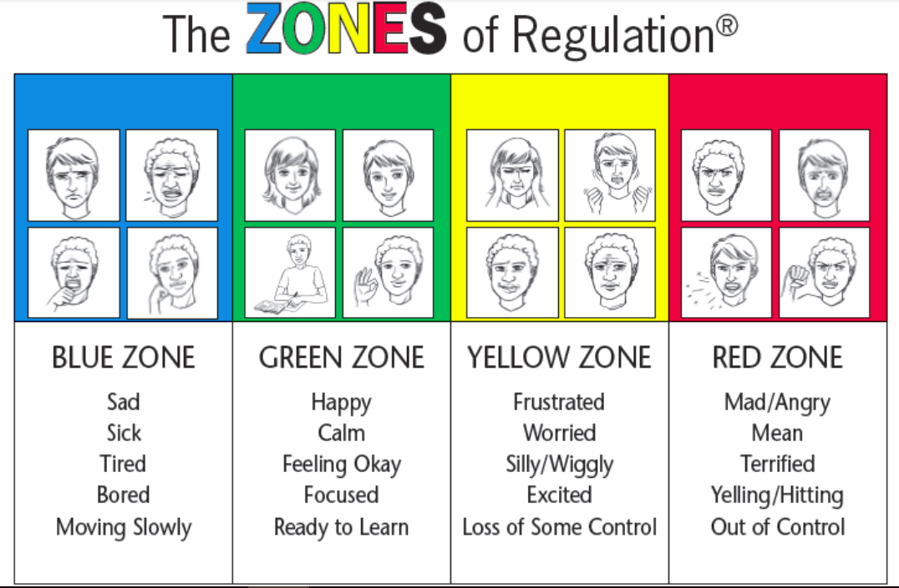
Zones of Regulation
We refer to the ‘Zones of Regulation’ to help pupils to think about their behaviour and how it impacts others.

Slide 10
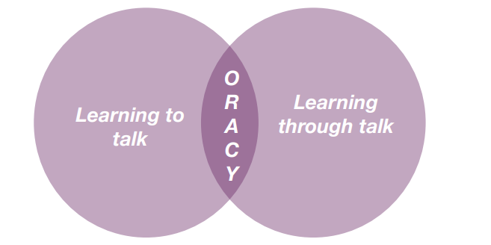
Oracy
DfE: ‘The value of talk to children’s mastery of language is as important for writing as it is for reading. Pupils should be taught how to engage in dialogue that enhances learning.
Oracy is the ability to articulate ideas, develop understanding and engage with others through spoken language.
As we build a culture of oracy across the school, listen out for these specific terms from St Agatha’s Oracy Framework: physical; linguistic; cognitive; and social and emotional.
Oracy is learning to talk and learning through talk. This is a school priority for this academic year to improve both spoken and written language.

Slide 11
Routines
Appropriate clothing for the weather – warm coats, rain coats, jumpers are essential as windows and doors will be opened for ventilation and children will be going outside in all weathers.
Water bottle - children can refill in the classroom. Please make sure it is named. If your child would like milk, please order it for them.
Bag - will be placed in their locker
Lost property – please look in the black tub or hanging up by the shed in the playground.
PLEASE LABEL CLOTHING

Slide 12
Uniform
Full school uniform – Summer/Winter
Black school shoes – no trainers (except on PE days)
Only the school logo is be on clothing that is worn to school
Long hair tied back. Hair accessories must be plain, small and school colours/black/brown.
Small stud earrings allowed – do not wear on PE days. They should be taped over if newly pierced.
Watches are allowed (not smart watches)
No other jewellery
No nail varnish
Suitable outdoor coat appropriate for the weather; we will still use the playground if it is raining (not torrential).

Slide 13
Online Safety
Smart Devices - mobile phones and smart watches
Following updates to national safeguarding expectations, St Agatha’s is moving to become a smart device-free environment, which includes no smart phones and smart watches in school for children.
There are special circumstances where there are exceptions to this rule, such as if a child requires a mobile phone to monitor a medical need.

Slide 14
P.E.
Winter uniform
White PE t-shirt
Navy tracksuit bottoms
Red school tracksuit top
Sports trainers - not fashion trainers
Only the school logo is to be worn on clothing including socks
Summer uniform
White PE t-shirt
Red shorts
Sports trainers - not fashion trainers
Only the school logo is to be worn on clothing including socks

Slide 15
Active Minutes
“ Children and young people should engage in moderate to vigorous physical activity for an average of at least 60 minutes per day across the week. This can include all forms of activity such as physical education, active travel, after-school activities, play and sports” - GOV.UK
Children aged 5 and above should aim for at least 60 active minutes a day.
At school, we promote physical activity through PE, the Daily Mile, outdoor play and active learning.
At home, parents can help by encouraging walking, active play, family outings and active travel wherever possible.
Together, we can help children build healthy habits and meet the recommended levels of daily activity.

Slide 16
Home Learning
An e-book will be provided once a week.
Numbots

Slide 17
Home Reading
Children will read three times a week in school.
An e-book will be allocated to your child. You will have receive log in details to access this at home.
Please listen to your child read their book and make a comment in their reading record.
The reading record stays in school in the week and will be sent home on weekends for you to comment.
Please make sure it is in their bag on Mondays.
Please read as much to your child as much as possible and encourage them to read books, magazines, signs, labels etc

Slide 18
School Library
The class will go to the library once a week.
They will be able to choose one book to take home.
Please make sure they return the book the following week; otherwise, they will not be able to take another book out.
Library day is Wednesday.

Slide 19
PSA and Class Reps
All of the adults in our school community are automatically members of the PSA.
The PSA do a fantastic job in supporting the children of St Agatha’s. Please do volunteer your time and support where you can.
Those able to take on the role of class rep are greatly appreciated. It is not a huge job!

Slide 20
Drop off and pick up…
Children line up outside the Year 1 outdoor area when the bell is rung at 8.45am.
Pick up is at 3:15pm- please wait on the main playground.
Collections – please provide written permission to the school office or email the office, if another adult is going to collect your child.
At the end of the day, children must tell their teacher who is there to collect them before they leave.

Slide 21
Key Dates
Autumn and Spring Term: Parent / Teacher Consultations – school closes at 12pm
Thursday 15th October
Thursday 4th February
Summer Term: Written reports
PE Kit Days –
Friday (outdoor) & Monday (indoor) – these days may change through the year.
Children are to come into school wearing their PE kit on their PE days.
Please make sure earrings are removed at home on PE days.
Rockstars and Robots Day - Friday 18th September
Oracy Vocabulary Day - Friday 2nd October
KS1 Christmas Nativity - Tuesday 8th December at 2pm

Slide 22
Thank you for coming!
Thank you for joining us this evening!

