Slide 1
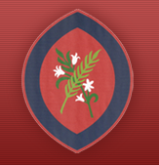

Reception Information Evening
September 2026
Learning Together in God’s Love

Slide 2
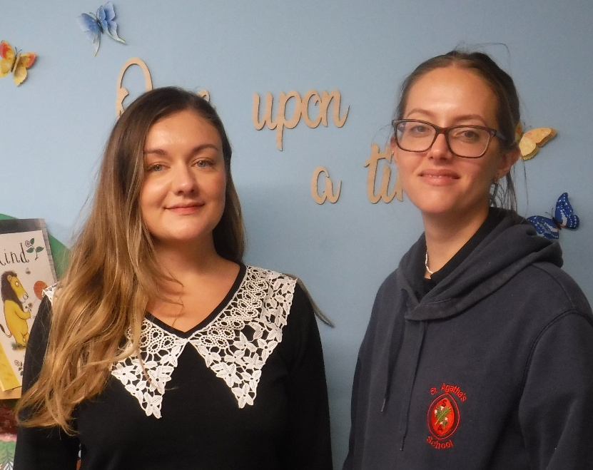
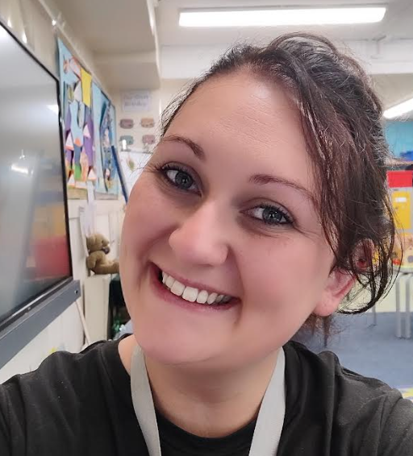
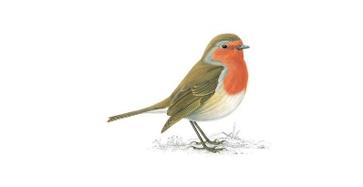
Welcome to Reception
(Robins
Class)
Meet the Team
Miss Ciubrinskaite
Miss Kirmatzis
Mrs Byrne

Slide 3
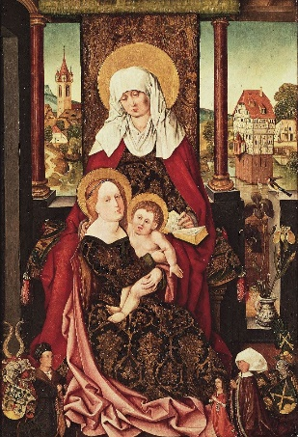
Class Saints
Robins - St Anne
Patron Saint of Grandparents
July 25th

Slide 4
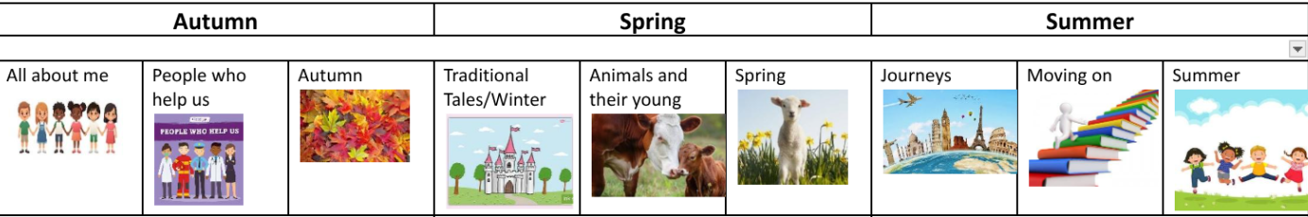
Topics

Slide 5
School Life
Morning playtime is at 10:15am
Lunchtime is 11:45am in the hall
Afternoon play is for 15 minutes, usually at 2pm
Home time is at 3:10 - 3:15pm. Children need to wait in the line until the teacher has seen the parent/carer and called the child by name
INSET – school is closed for staff training
Non-Uniform Day – children bring a contribution and can wear their own clothes
End of term – Christmas, Summer and Easter - school closes at 1:30pm
Please regularly check emails

Slide 6
Day to Day...
Children must bring in a waterproof or a coat, as appropriate, as we go outside in all weathers!
Water bottle - please make sure it is named.
Snack Time - the school provides fruit for your child at snack time.
Your child should have a school bookbag which goes into the book bag box in class.
Milk is free until they become 5; then it has to be paid for.
Lunch in the hall 11:45am – 12:15pm
Lunch play in the Early Years garden and then the main playground later in the year 12:15pm – 12:45pm
Children should come into the classroom at 8.45am when the bell is rung.
School pick up at 3:10 - 3:15pm

Slide 7
Uniform
Full school uniform – Summer/Winter
Black school shoes – no trainers (except on PE days)
Only the school logo is be on clothing that is worn to school
Long hair tied back. Hair accessories must be plain, small and school colours/black/brown.
Small stud earrings allowed – do not wear on PE days. They should be taped over if newly pierced.
Watches are allowed (not smart watches)
No other jewellery
No nail varnish
Suitable outdoor coat appropriate for the weather; we will still use the the outdoor area and playground when it is raining (not torrential).

Slide 8
Online Safety
Smart Devices - mobile phones and smart watches
Following updates to national safeguarding expectations, St Agatha’s is moving to become a smart device-free environment, which includes no smart phones and smart watches in school for children.
There are special circumstances where there are exceptions to this rule, such as if a child requires a mobile phone to monitor a medical need.

Slide 9
P.E.
Winter uniform
White PE t-shirt
Navy tracksuit bottoms
Red school tracksuit top
Sports trainers - not fashion trainers
Only the school logo is to be worn on clothing including socks
Summer uniform
White PE t-shirt
Red shorts
Sports trainers - not fashion trainers
Only the school logo is to be worn on clothing including socks

Slide 10
Active Minutes
“ Children and young people should engage in moderate to vigorous physical activity for an average of at least 60 minutes per day across the week. This can include all forms of activity such as physical education, active travel, after-school activities, play and sports” - GOV.UK
Children in Early Years should aim for 180 active minutes each day, including at least 60 minutes of moderate-to-vigorous activity, while children aged 5 and above should aim for at least 60 active minutes a day.
At school, we promote physical activity through PE, the Daily Mile, outdoor play and active learning.
At home, parents can help by encouraging walking, active play, family outings and active travel wherever possible.
Together, we can help children build healthy habits and meet the recommended levels of daily activity.

Slide 11
Behaviour
‘DO YOUR BEST, LOOK YOUR BEST and ACT YOUR BEST’
We support children in helping them to understand that all actions/choices have consequences, both positive and negative. We encourage children to consider their choices and take responsibility for the consequences of these choices. We support children to reflect on the impact of unexpected behaviours on their own and others’ wellbeing.
We encourage children to focus their attention, to be ‘active listeners’ and to develop the capacity to make ‘good choices’ through noticing and praising positive behaviours.
In order to be able to challenge themselves and carry out tasks independently, children must be able to regulate their behaviour in the classroom.

Slide 12
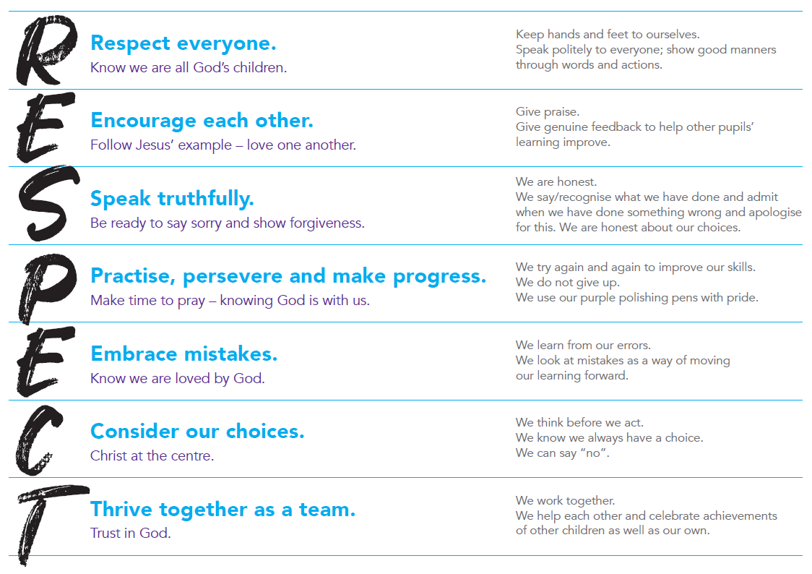
Behaviour
We prioritise the explicit teaching of expected and unexpected behaviours and relate this back to our RESPECT code.

Slide 13
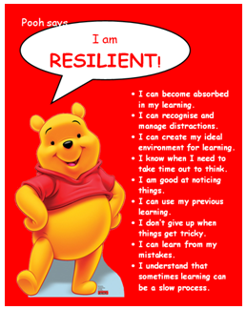
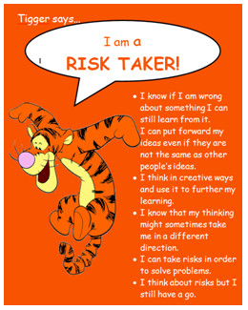
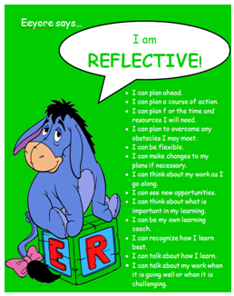

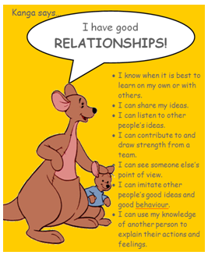
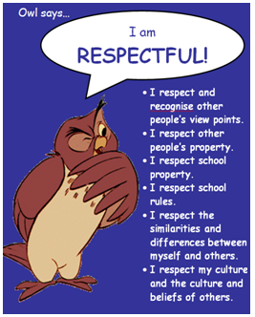
Learning to Learn…
Each half term, we focus on one of our Learning to Learn characters and Head Teacher certificates are awarded.

Slide 14
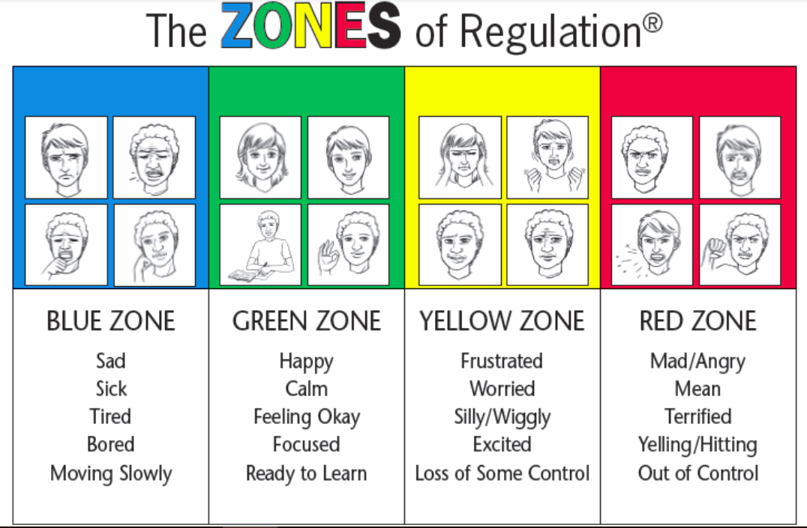
Zones of Regulation
We refer to the ‘Zones of Regulation’ to help pupils to think about their behaviour and how it impacts others.

Slide 15



Catholic Social Teaching
Your child will learn how they can apply the Catholic Social Teaching Principles in their learning and across school life.

Slide 16


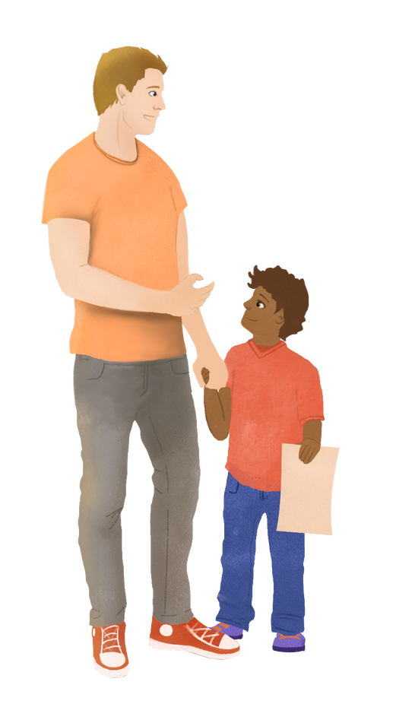
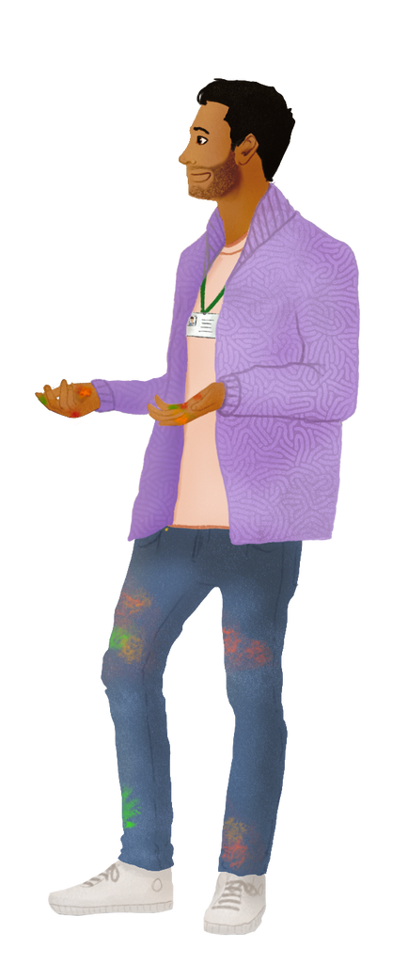
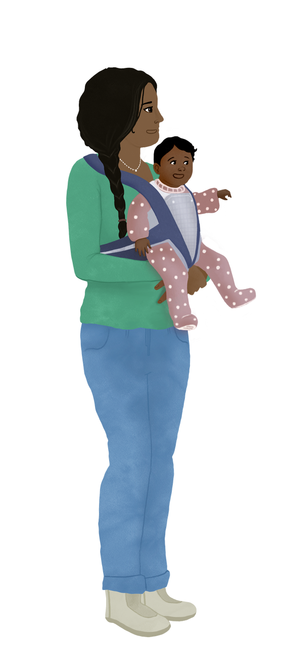
What is Tapestry Childhood Education Platform?
Tapestry is an online system that supports us with:
  Provides snapshots children’s learning and development
  Working in partnership with families and carers.

Slide 17
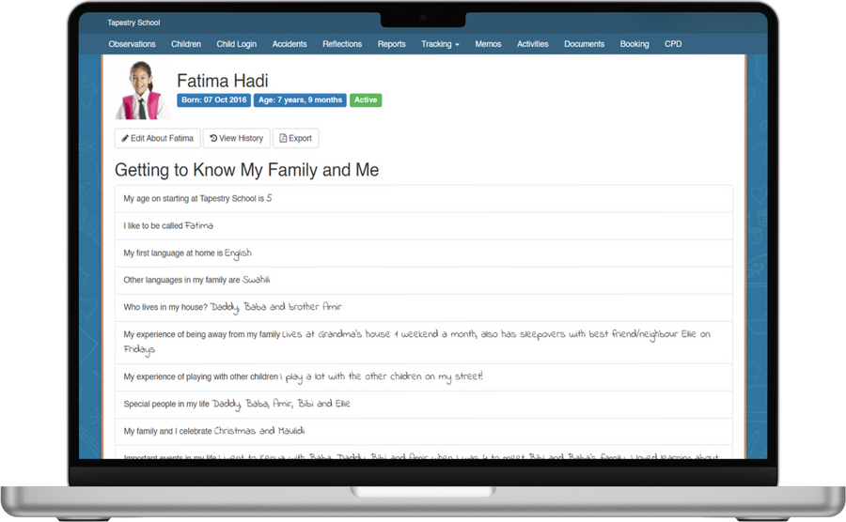
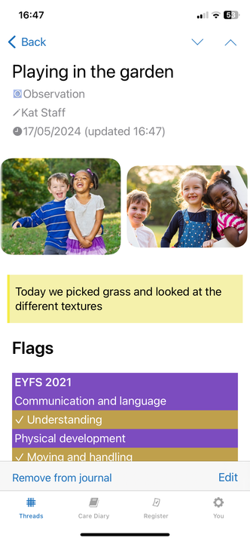
Documenting children’s learning and development
Each child will have their own learning journal on Tapestry so we can:
  Follow your child’s learning and development
  Plan experiences to help them to make progress
Through the journal we will share ‘observations’ with you.

Slide 18
Home Learning
We will be sending a Reception News page each week to let you know about some of your child’s class learning.
We will begin teaching phonics next week. E-books will be set once a week for you to read at home with your child once they can confidently blend.

Slide 19

Hello Little Wandle
Phonics

Slide 20
Little Wandle
Little Wandle Letters and Sounds Revised has been developed to ensure that we give every child the best possible opportunity to learn to read effectively.
Phonics teaching begins the week commencing Monday 21st September.
Reading practice will take place in school. They will read the same book during each reading session to develop their confidence. An e-book will then be sent home once a week so your child can show you what they’ve been doing at school.

Slide 21
School
Library
The class will be able to visit our library once a week to choose a book to take home to share. You should not ask your child to read this book to you - it is for you to read to them. Our library day is Monday.
Please make sure that they return this book the following week; otherwise, they will not be able to take another book out, but they will be able to browse.

Slide 22
Drop off and pick up…
Children come directly into class when the bell is rung at 8:45am. They must be in class by 8:50am for registration. Phonics starts at 9:00 sharp. It is important that they are sat and ready to learn.
Collection – Please provide written permission or email the office if another adult is going to collect your child.
At the end of the day, children must wait until their teacher calls their name to go to the parent. The teacher will not let the child go unless they have seen the responsible adult who has come to collect.

Slide 23
PSA and Class Reps
All of the adults in our school community are automatically members of the PSA.
The PSA do a fantastic job in supporting the children of St Agatha’s. Please do volunteer your time and support where you can.
Those able to take on the role of class rep are greatly appreciated. Thank you so much for volunteering.

Slide 24
Key Dates
Autumn and Spring Term: Parent / Teacher Consultations – school closes at 12pm
Thursday 15th October
Thursday 4th February
Summer Term: Written reports
Individual and sibling photo day - 14th October
Christmas Nativity – Wednesday 9th December 9.15am
Collective Worship - 18th March

Slide 25
Thank you for coming!
Thank you for joining us today.
We are all looking forward to an exciting,
fun-filled Reception year.

